Slide 1
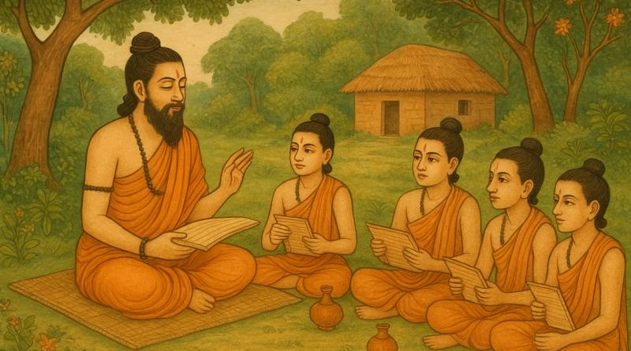
Role of Gurus in Vedic Perspective
Prem Bahadur Bishokarma
M. Phil Scholar (23rd Batch)
GSE, Kirtipur (TU)

Slide 2


Presentation overview
Introduction of Vedic Perspective
Education System
Role of Gurus
Critical Reflection
Conclusion
Prem Bahadur Bishokarma
M. Phil Scholar (23rd Batch)
GSE, Kirtipur

Slide 3
Vedic Perspective
Vedic Period : (1500-500 BCE)
Human civilization : Vedas, Upanishads and other Hindu Religious Books,
Region : Indus Valley Civilization (The Gangetic Plain)
State: No any but Janapads (Tribal clan-based kingship), later Mahajanapads
Economy: Semi-nomadic, cattle were sources of wealth
Society : Rigid Varna System (Caste System)
Language : Sanskrit
Prem Bahadur Bishokarma
M. Phil Scholar (23rd Batch)
GSE, Kirtipur

Slide 4
Vedic Education System
1. Core Philosophy: Guided by Hindu Philosophy and Literature as Vedas,
Upanishads, Puranas etc.
2. Center of Learning: Gurukuls and Ashrams (India and Nepal)
3. Enrollment: After Upanayana (8, 11 and 12)
4. Beneficiaries: Basically Brahmins, later Kshatriyas and Vaishyas (Male for
Ruling)
5. Goal: Truth and Supreme Conscious (Dharma, Artha, Kama and Moksha)
6. Gurus known as: Acharyas
Prem Bahadur Bishokarma
M. Phil Scholar (23rd Batch)
GSE, Kirtipur

Slide 5
Aims of Education
Supreme consciousness,
Righteousness,
Preserve and spread culture,
Unfold spiritual and moral power,
Perfection in physical,
mental and intellectual aspects,
Moral character,
Social and civic duties,
Vocational skill,
Wealth,
Positive attitude
and dignity of labour etc.
Prem Bahadur Bishokarma
M. Phil Scholar (23rd Batch)
GSE, Kirtipur

Slide 6
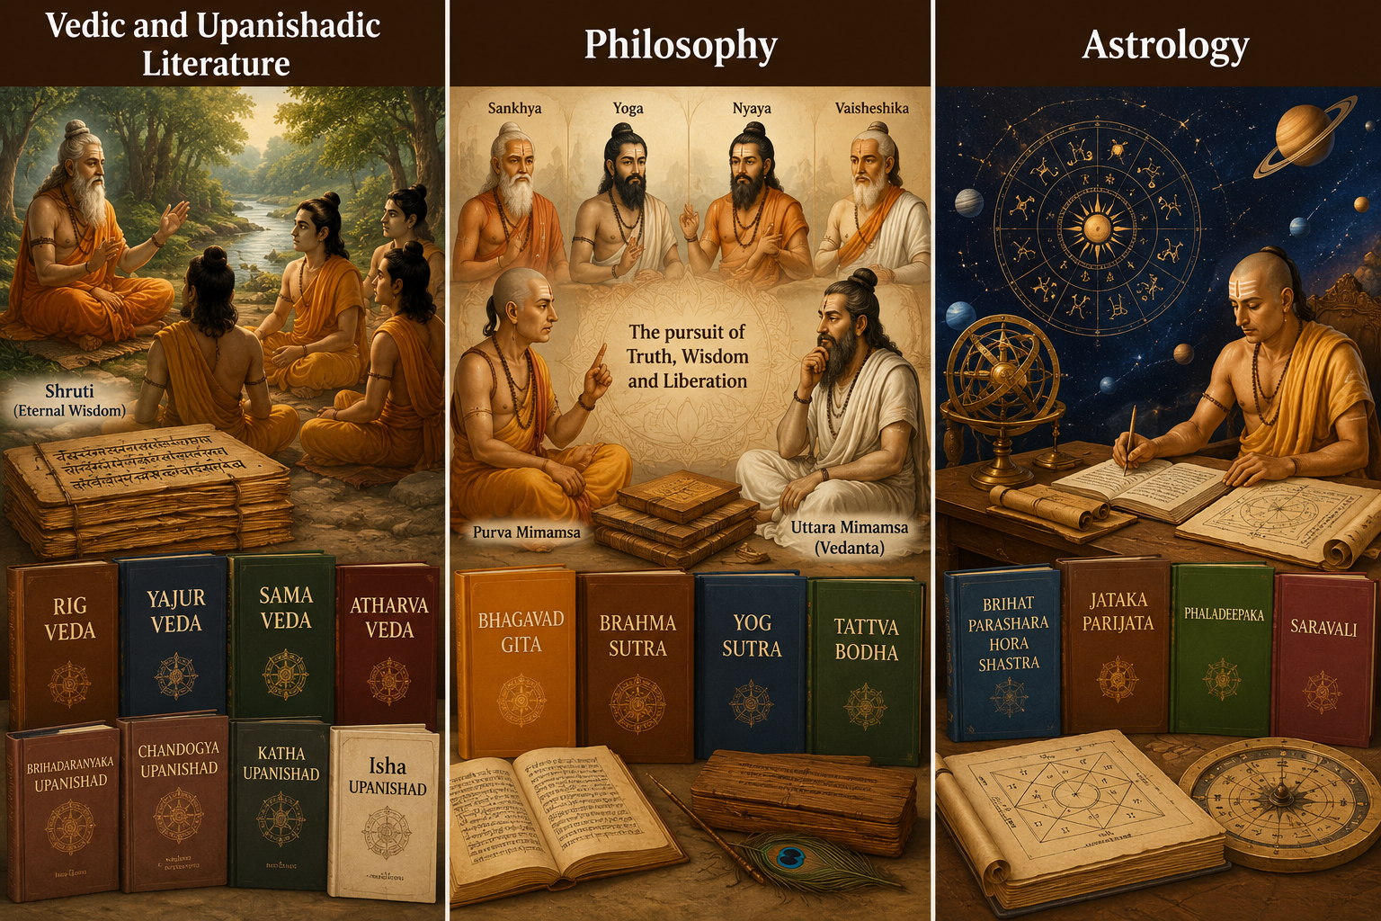
Areas of Study
Vedic and Upanishadic literature
Philosophy
Astrology
Grammar and Art
Sanskrit Language
Logic and Mathematics
Ethics etc.
Prem Bahadur Bishokarma
M. Phil Scholar (23rd Batch)
GSE, Kirtipur

Slide 7
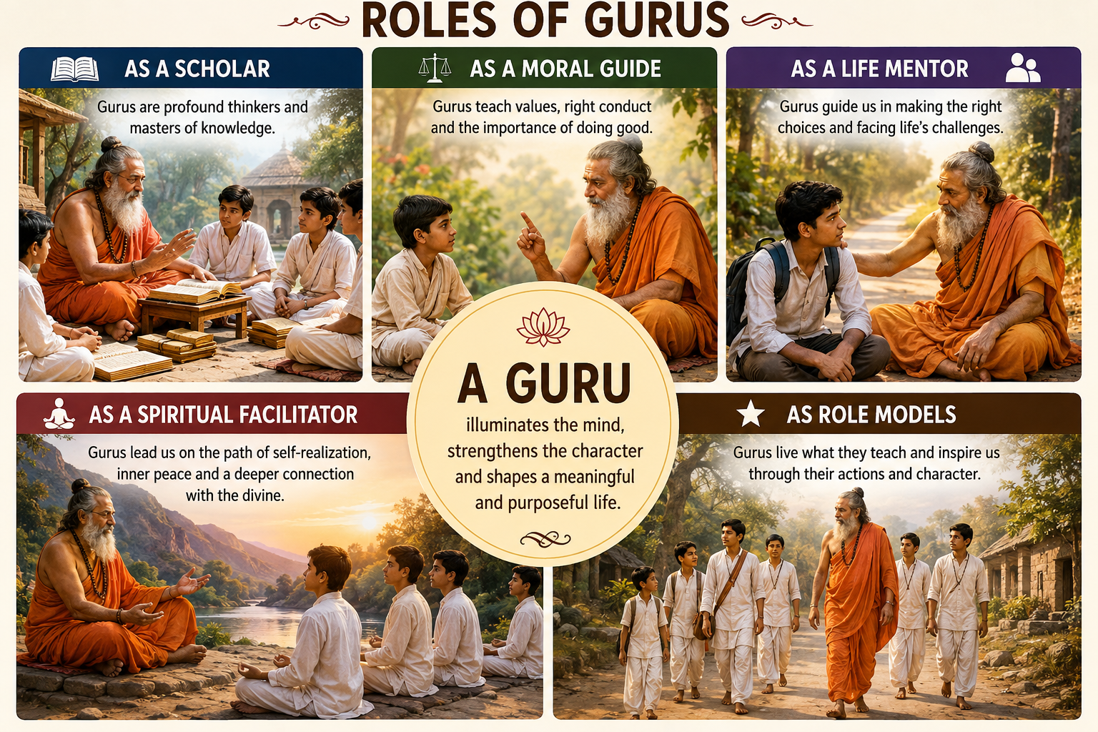
Role of Gurus
a scholar
a moral guide
a life mentor
a spiritual facilitator
a role model
Tripathi, Meenakshi (2024)
Prem Bahadur Bishokarma
M. Phil Scholar (23rd Batch)
GSE, Kirtipur

Slide 8

Role of Gurus as…
Lust - love
Rage - compassion
Greed - benevolence
Infatuation - auspiciousness
Arrogance - selfless action
Jealousy – forgiveness
Neupane, B.P (2023)
Prem Bahadur Bishokarma
M. Phil Scholar (23rd Batch)
GSE, Kirtipur

Slide 9
Critical Analysis
Acharya or Guru – All in all (knowledge, character, discipline)
Learning environment – Natural, simple, living and learning
Disciples – Bramhachari (Upakurvana and Naisthika)
Vidya – Education without Samskar incomplete
Education for – Holistic development (Ultimate goal - Moksha)
Guru-shishya relation in core
Prem Bahadur Bishokarma
M. Phil Scholar (23rd Batch)
GSE, Kirtipur

Slide 10
Critical Reflection
Access – (Hindus, Brahmins, Kshatriyas, Vaishyas, Male)
Dependency and Domination – All in all Gurus and Acharyas
Lecture and memorization
Social Hierarchy and stratification of society was promoted
One-size-fits all model of curriculum and delivery
No standards for evaluation and certification
Prem Bahadur Bishokarma
M. Phil Scholar (23rd Batch)
GSE, Kirtipur

Slide 11
Conclusion
Established the tradition of learning
Prepared leaders, rulers and businessmen
Contributed to economic development and social discipline
Maintained moral and ethical rules for humanity
Preserved culture and transferred learned knowledge and skills
Guided human civilization except having some limitations
Prem Bahadur Bishokarma
M. Phil Scholar (23rd Batch)
GSE, Kirtipur

Slide 12
References
Rajguru, N. (2024). The Gurukul System: Ancient pedagogical Practices and their Role in Shaping Indian knowledge traditions. International Journal For Multidisciplinary Research. https://doi.org/10.36948/ijfmr.2024.v06i06.32743
Timilsina, R. R. (2016). Gender Perspective to Vedic Education: Current Practices in Nepal. Dhaulagiri Journal of Sociology and Anthropology, 10, 144- 165. https://doi.org/10.3126/dsaj.v10i0.15884
Bhatia, K. (2026). Guru-Sisya Parampara: Eternal Bond of Learning. Indian Knowledge Systems: Journey from Vedic Wisdom to Digital Repositories, 12.
Prem Bahadur Bishokarma
M. Phil Scholar (23rd Batch)
GSE, Kirtipur

Slide 13

Tripathi, M. Bhartiya Āchārya Paramparā and the relevance of pedagogy in the Indian Knowledge System in the present teacher education programme.
Das, G. (2025). The Guru-Śiṣya Paramparā: Understanding the Teacher-Student Tradition. NBPA Journal for Arts, Humanities & Social Sciences, 1(3), 28-44.
Roy, D. C., & Roy, P. (2025). Pedagogy of Dharma: Revisiting Gurukula learning systems for 21st century Education. Indian Knowledge System (IKS), 74.
Prem Bahadur Bishokarma
M. Phil Scholar (23rd Batch)
GSE, Kirtipur

Slide 14
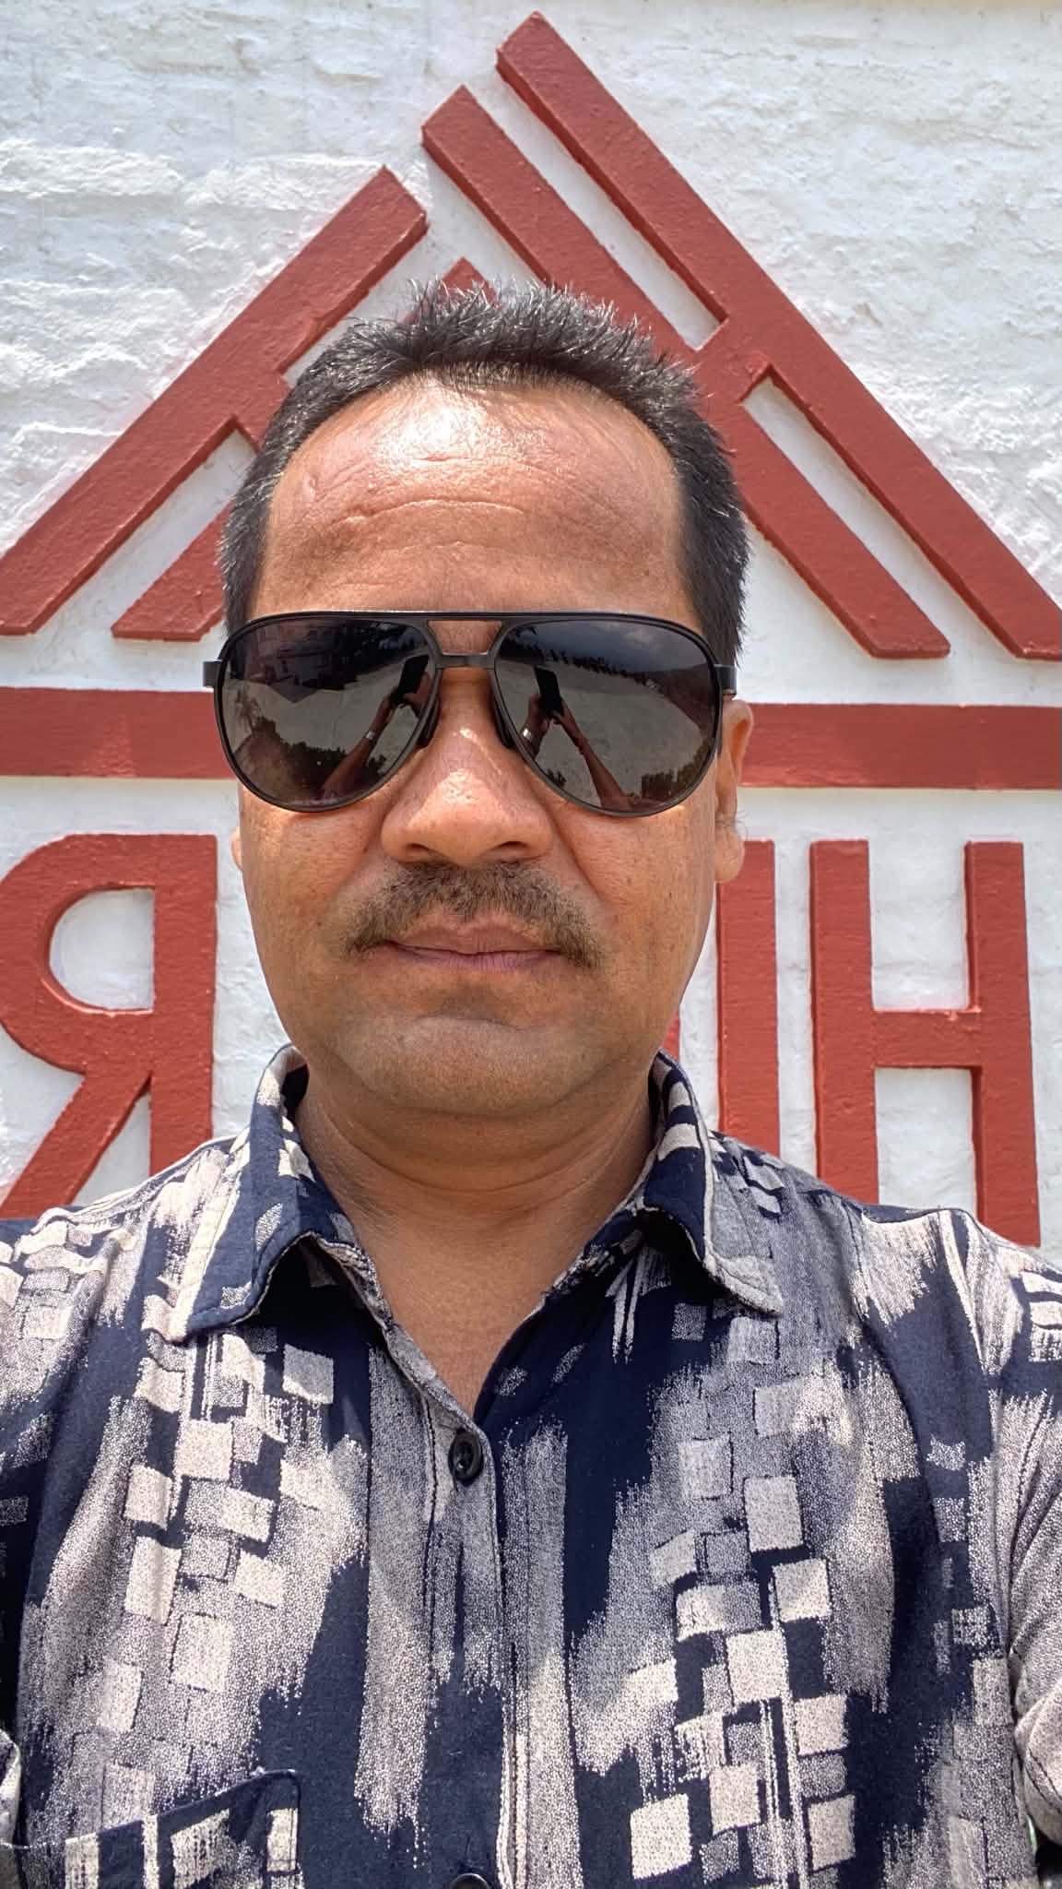
Thank you!
Prem Bahadur Bishokarma
M. Phil Scholar (23rd Batch)
GSE, Kirtipur

Slide 15
From Bir Bdr. Chalaune
All the information that attached in every slides are very valuable and informative. So, I wish the presentation will be gone very successfully more than previous presenter.
If it is suitable to place anywhere, I have added slide 16 here.
If possible, Add One Guru Mantra From Ved or Upanisad or Ramayan or Mahabharat or Sanskrit by citation.

Slide 16
